Slide 1
Peripheral Neuropathy Special Presentation:
Infrared Light for Neuropathy
Len Saputo, MD
www.DoctorSaputo.com
Link to free Peripheral Neuropathy Health Assessment:
http://doctorsaputo.com/a/peripheral-neuropathy-health-assessment
May 13, 2015
Alta Bates Summit
Comprehensive Cancer Center

Slide 2
How I became Interested in IR Light Therapy
Called Maurice Bales in 1999
Treated more than 30 patients with him
Decided to treat patients with infrared light
Worked with Maurice to develop new approaches over the past 16 years
Published a self-funded clinical study on diabetics with advanced painful neuropathy
Now involved with another study at UCSF on CIN

Slide 3
Types of Peripheral Neuropathy
Sensory: transmit touch, pain, vibration & temperature
Motor: control movement of your muscles
Autonomic: control the sympathetic & parasympathetic nervous system

Slide 4
Symptoms of Peripheral Neuropathy
Gradually worsening numbness of feet & hands that spreads up towards the legs and arms
Loss of balance & coordination (proprioception)
Burning pain, usually worse at night & can be severe

Slide 5
Complications of Peripheral Neuropathy
Skin ulcers
Infection
Amputation
Fractures

Slide 6
How to Diagnose Peripheral Neuropathy
History and neurological physical exam
Electromyogram (EMG)
CT or MRI
Blood tests: AIC, B-12, toxic chemicals, cancer markers, hemoglobin electrophoresis
Biopsy of skin and/or nerve
Infrared imaging

Slide 7
Causes for Peripheral Neuropathy
Diabetes
Chemotherapy
Alcoholism
Toxic exposures: metals or chemicals
Medications
Vitamin deficiencies
Pressure on nerves in the spine

Slide 8
Drugs Causing Peripheral Neuropathy
Dilantin
Indocin
Statins
Allopurinol
Anti-retroviral drugs: Hivid, Videx, Zerit, Ziaagen, AZT
Many antibiotics: Flagyl, Fluoroquinolines, Furadantin, Suramin, INH, Chloroquin, Ethambutol, Zyvox, & more!
TNF-alpha antagonists: Enbrel, Remicade, Humira, Simoni, Cimzia

Slide 9
Chemotherapy Peripheral Neuropathy
Platinum based drugs: cisplatin, carboplatin, oxaliplatin
Taxanes: Taxol, Taxotere, Jevtana
Epothilones: Ixempra
Plant alkaloids: vinblastine, vincristine, vinorelbine
Thalidomide, Revlimid, Pomalyst
Velcade & Kyprolis
Halaven

Slide 10
UCSF Study on Chemotherapy Induced Neuropathy
PI is Christine Miaskowski, PhD, RN, at UCSF
Five year pilot study to see if infrared light reduces pain and increases sensation in CIN
Previous study we showed infrared light improved sensation and increased quality of life in diabetic neuropathy. It showed reduced pain at .05 significance

Slide 11
Treatment of Peripheral Neuropathy
No treatment to reverse numbness or balance
Pain management is the central treatment
Acupuncture
Biofeedback
Nutritional support
Infrared light therapy
Pulsed electromagnetic field therapy

Slide 12
Nutritional Treatment of Peripheral Neuropathy
B-12
Alpha lipoic acid
Fish oil
GLA
Acetyl l-carnitine
Benfotiamine (from B-1)
L-glutamine
Gluten free diet

Slide 13
Infrared light: How it works
Increases circulation (releases NO)
Stimulates Collagen Production
Speeds healing rate by 40%
Increases ATP Production & Release
Increases RNA and DNA Synthesis
Reduces inflammation
Increases Lymphatic Drainage
Stimulates Fibroblastic Activity
Anti-microbial (blue light)
Increases Phagocytosis
Reduces Excitability of Nervous Tissue (relieves pain)

Slide 14
Three kinds of nitric oxide synthase
NOS-1 is in nerve & is involved with nerve transmission
NOS-2 is called inducible or iNOS. Generates tons of NO & repairs tissue damage, hypoxia, bacterial infection.
eNOS is endothelial NOS. Present in all blood vessels & lymphatic ducts. Stimulates increased flow & causes angiogenesis, which is needed for tissue repair.

Slide 15
Infrared light & Nitric Oxide
NO stimulates growth, enhances immunity, is a neuromodulator, & stimulates stem cell proliferation
NO is impt in analgesia, vasodilation, & angiogenesis
NO is anti-cancer, anti-inflammatory, & antimicrobial
NO donors such as NTG, l-arginine are widely prescribed
Most chronic disease are assoc with abn NO production

Slide 16
Long Term NO Problems
Generation of reactive nitrogen species
Inhibition of mitochondrial ATP production
Reversible binding of NO to cytochrome C oxidase and sensitizing tissues to hypoxia
Peroxynitrite irreversibly inhibits mitochondrial ATP production, increases cell permeability and induces cell apoptosis

Slide 17
Solution is Combination Rx
Use NO donor with antioxidants to reduce ROS & RNS and maintain NO bioavailability
Use low level laser therapy (LLLT) to dissociate NO from cytochrome C oxidase, hemoglobin, & myoglobin; this allows more O2 in tissues
Released NO stimulates stem cell proliferation and differentiation

Slide 18
LLLT + NO + Antioxidants
Blue LLLT increases platelet-rich plasma effectiveness by increasing NO-deoxyhemoglobin disassociation, shifting blood redox to reduction state, decreases PN levels, and increase NO bioavailability to PRP
LLLT, PRP, NO, & AOs increase efficacy of stem cell Rx and NO + PDGF stimulates stem cell proliferation and differentiation

Slide 19
Infrared & Red LLLT in Healthy Tissue
Normally some cytochrome C oxidase is bound to NO, which inactivates it
Red and infrared LLLT dissociates NO from it
Increased NO causes stimulation of stem cell proliferation and differentiation
ROS levels increase and shift redox state to oxidative

Slide 20
Infrared & Red LLLT in Hypoxia or Oxidative Stress
NO is dissociated from cytochrome c oxidase & incr ATP
There’s stimulation of stem cells & vasodilation
Levels of reduced glutathione increase
Cellular redox shifts to reduction & decreased inflammation

Slide 21
Blue LLLT Therapy
NO dissociates from deoxyhemoglobin in RBCs
Free NO reacts with ROS to form peroxynitrite, which is converted to nitrite
Nitrite is converted to NO + H2O by deoxyhemoglobin
Net result: ROS decreases, NO is increased, and the redox is shifted to reduction

Slide 22
NO, Redox, & Immunity
Low NO causes Th1 dominance & incr cellular immunity
High ROS also causes Th1 dominance causing oxidative stress and inflammation
Increasing NO shifts Th1 to Th2 & decr inflammation
Increased NO shifts COX2 & LOX to COX1
Blue LLLT shifts redox to reduction and Th1 to Th2

Slide 23
Nitrophotonics
NO is likely impt in all pathologies; it is ubiquitous
Using NO donors with AOs and LLLT promises to treat a wide range of difficult to treat pathologies
Photobiomodulation balances the immune system, activates mitochondria, adjusts redox & increases NO
Activated stem cells are the final common pathway that heals underlying pathology

Slide 24
Nitrophotonics & Hydrogen
Molecular H2 can convert oxygen radicals to water and it is readily available because of its small molecular size
H2 increases the body’s own antioxidant system that included glutathione
H2 exerts a beneficial effect on cell signaling, cell metabolism and gene expression

Slide 25
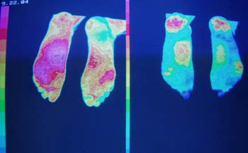
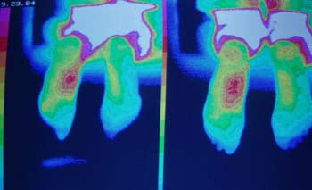
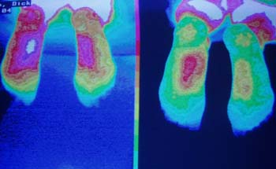
Diabetic Neuropathy
Notes:
64 year old tennis player with type II diabetes was treated over 4 days. Symptoms recurred in a week…lived in LA and did not return

Slide 26
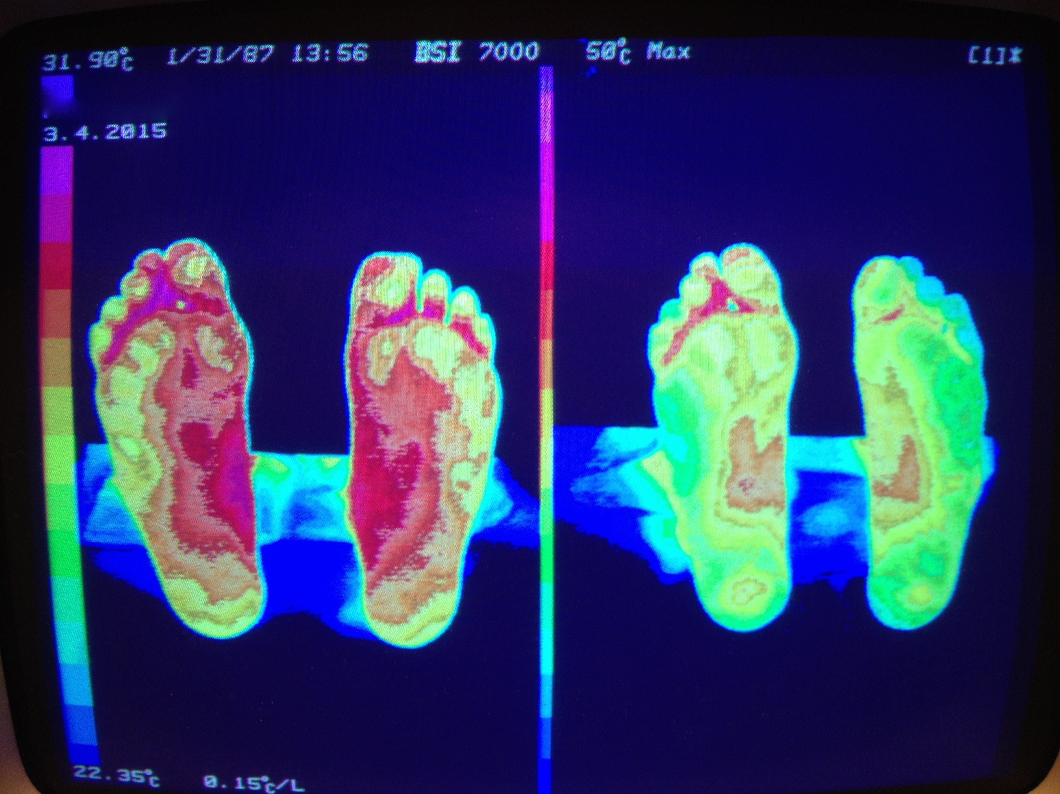
Diabetic Neuropathy
Notes:
60 year old female Yoga instructor with type II diabetes was treated over 4 days. Burning cleared and numbness and balance improved dramatically.

Slide 27
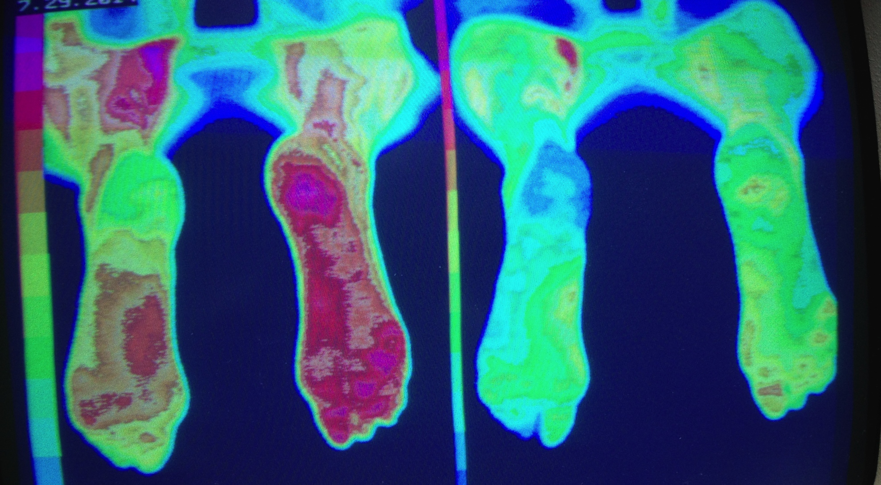
Diabetic Neuropathy
Notes:
64 year old tennis player with type II diabetes was treated over 4 days.

Slide 28
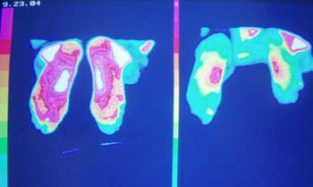
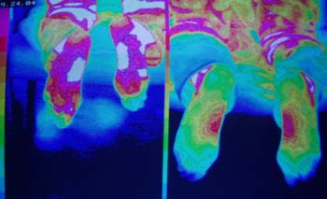
Chemotherapy Neuropathy
Notes:
62 year old male with melanoma and chemotherapy induced painful peripheral neuropathy

Slide 29
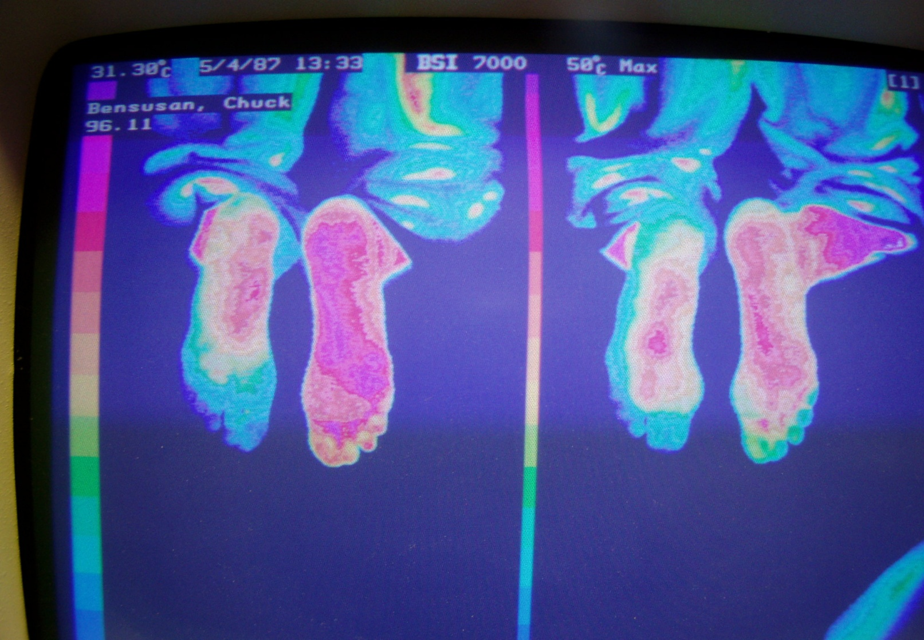
Chemotherapy Neuropathy after Heart Transplant
Notes:
68 year old MD had a heart transplant and CIN…cleared after 4 treatments.

Slide 30
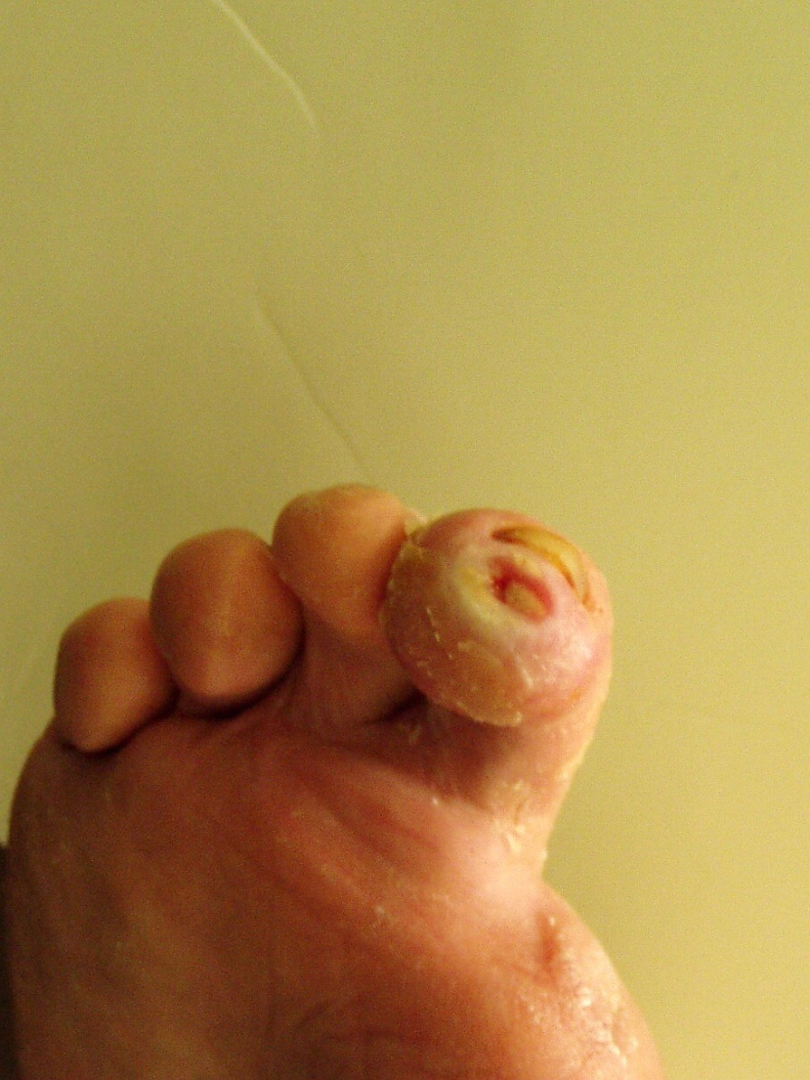
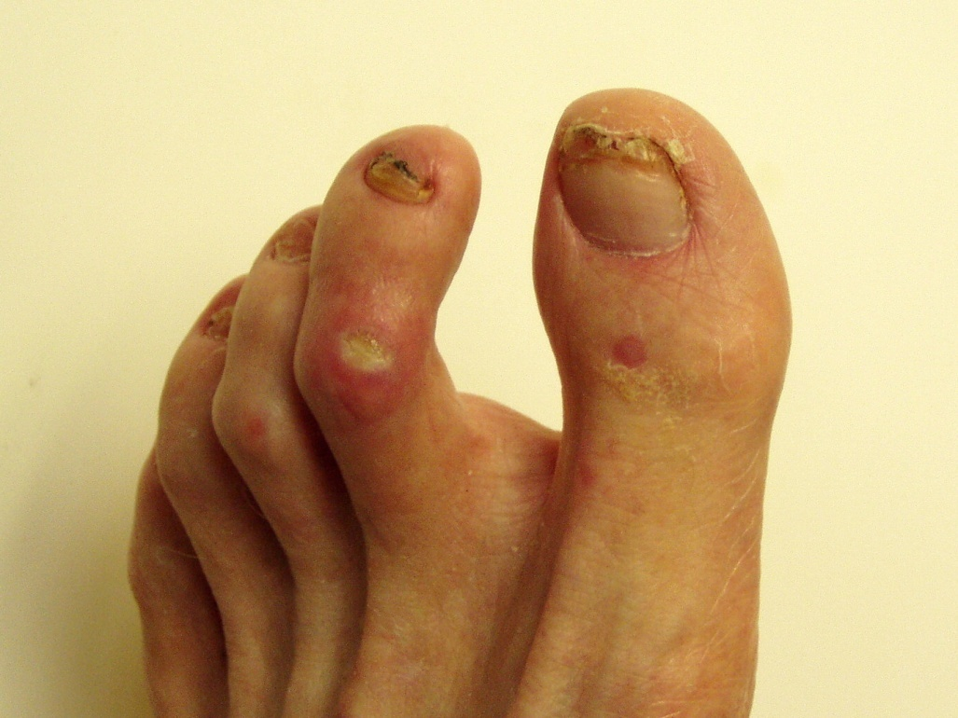
Diabetic Peripheral Neuropathy, Ulcerations, and Osteomyelitis Pre-Treatment

Slide 31
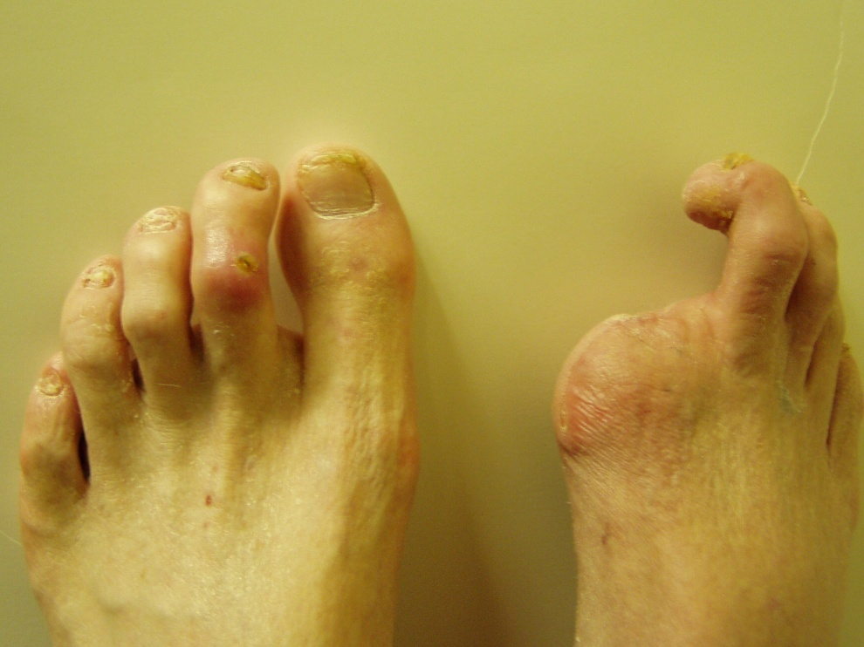
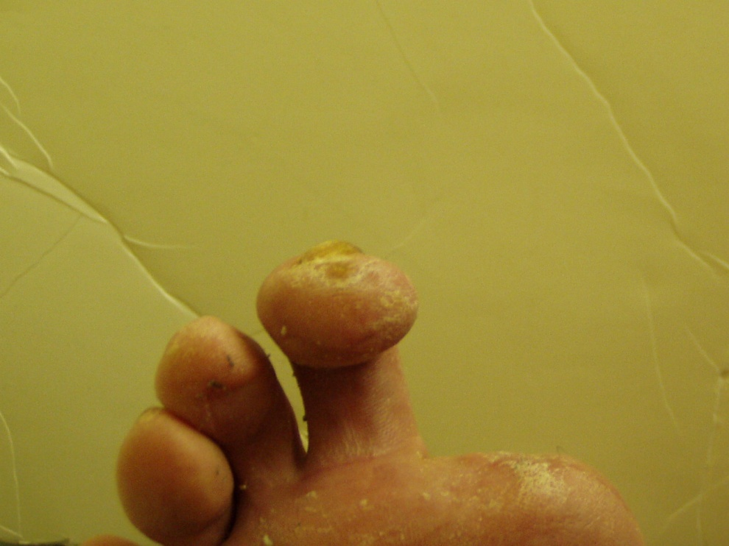
Diabetic Ulcers Post Treatment

Slide 32
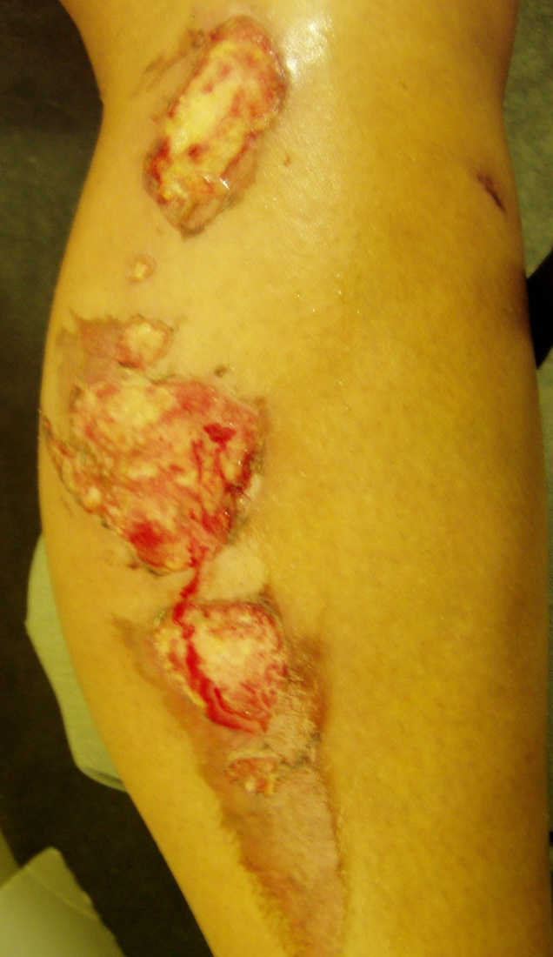
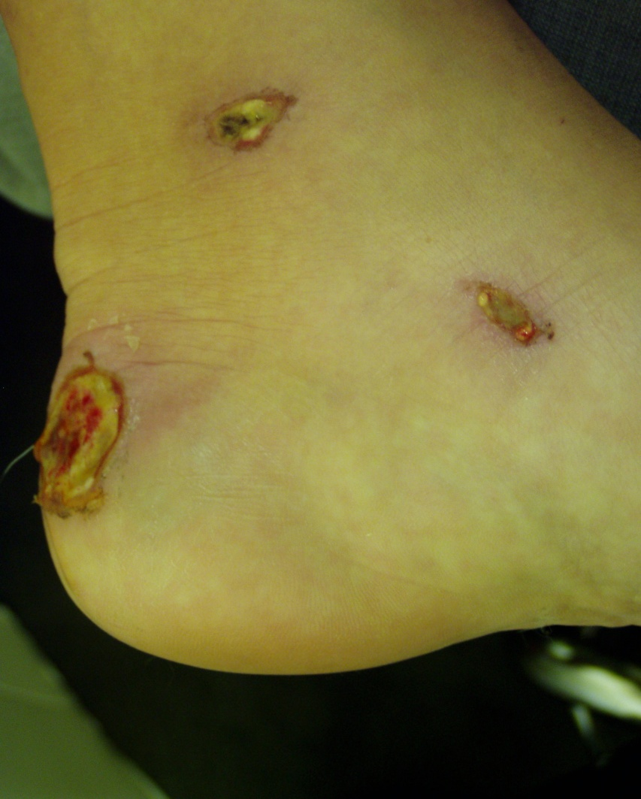
Auto Accident Pre-Treatment
Notes:
38 year old female in auto accident

Slide 33
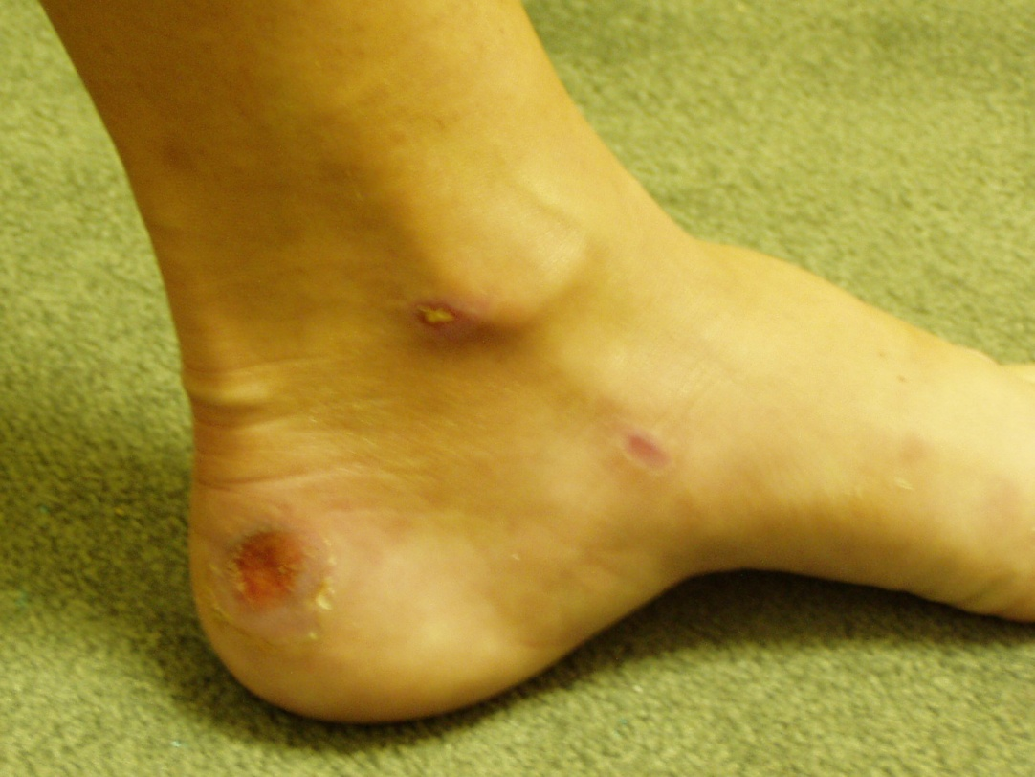
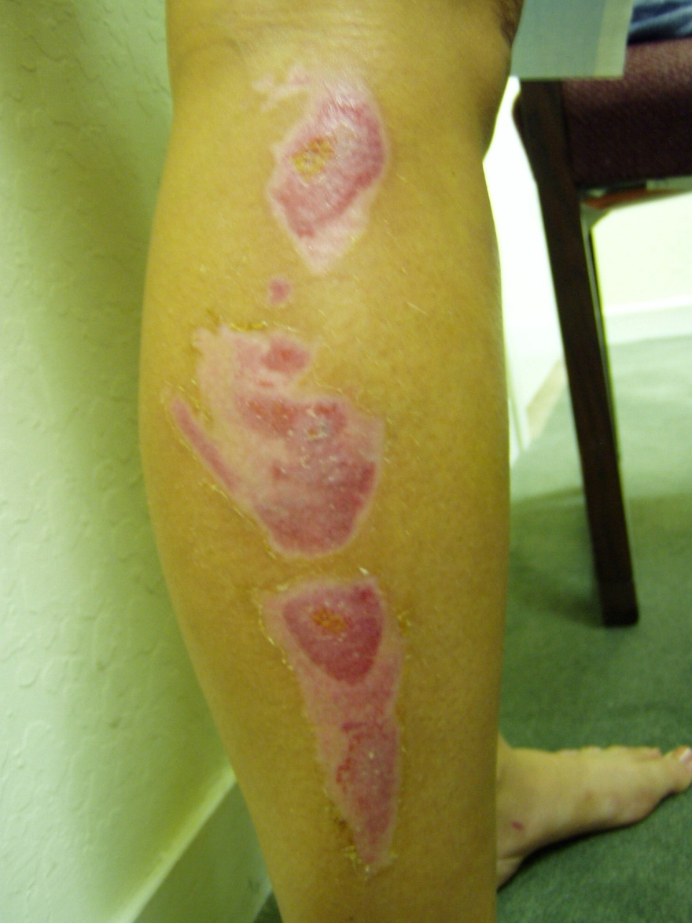
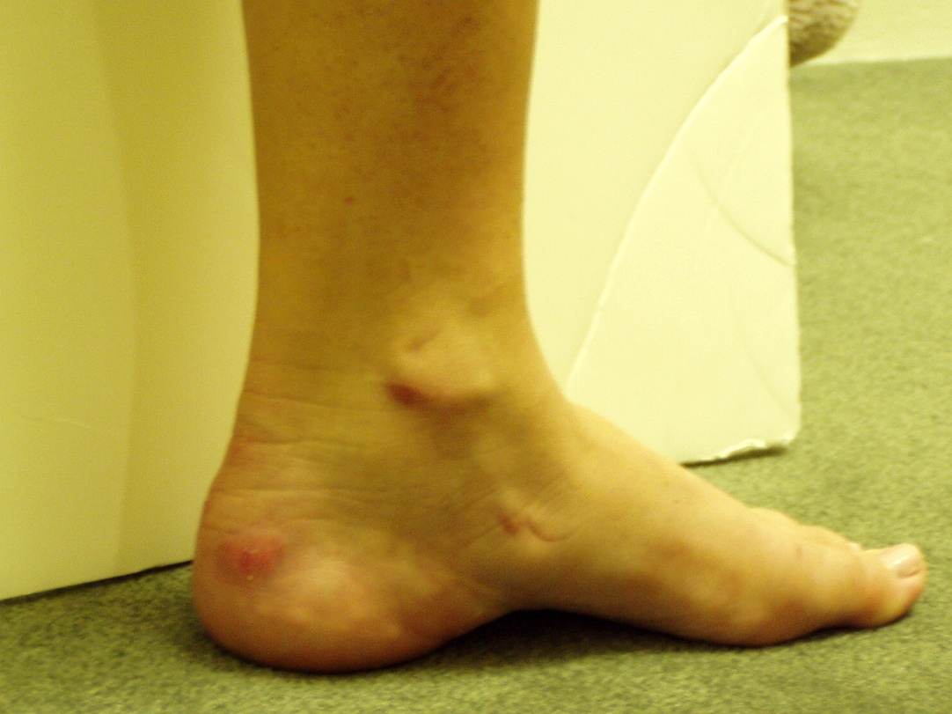
Auto Accident 12 Days Post Treatment

Slide 34
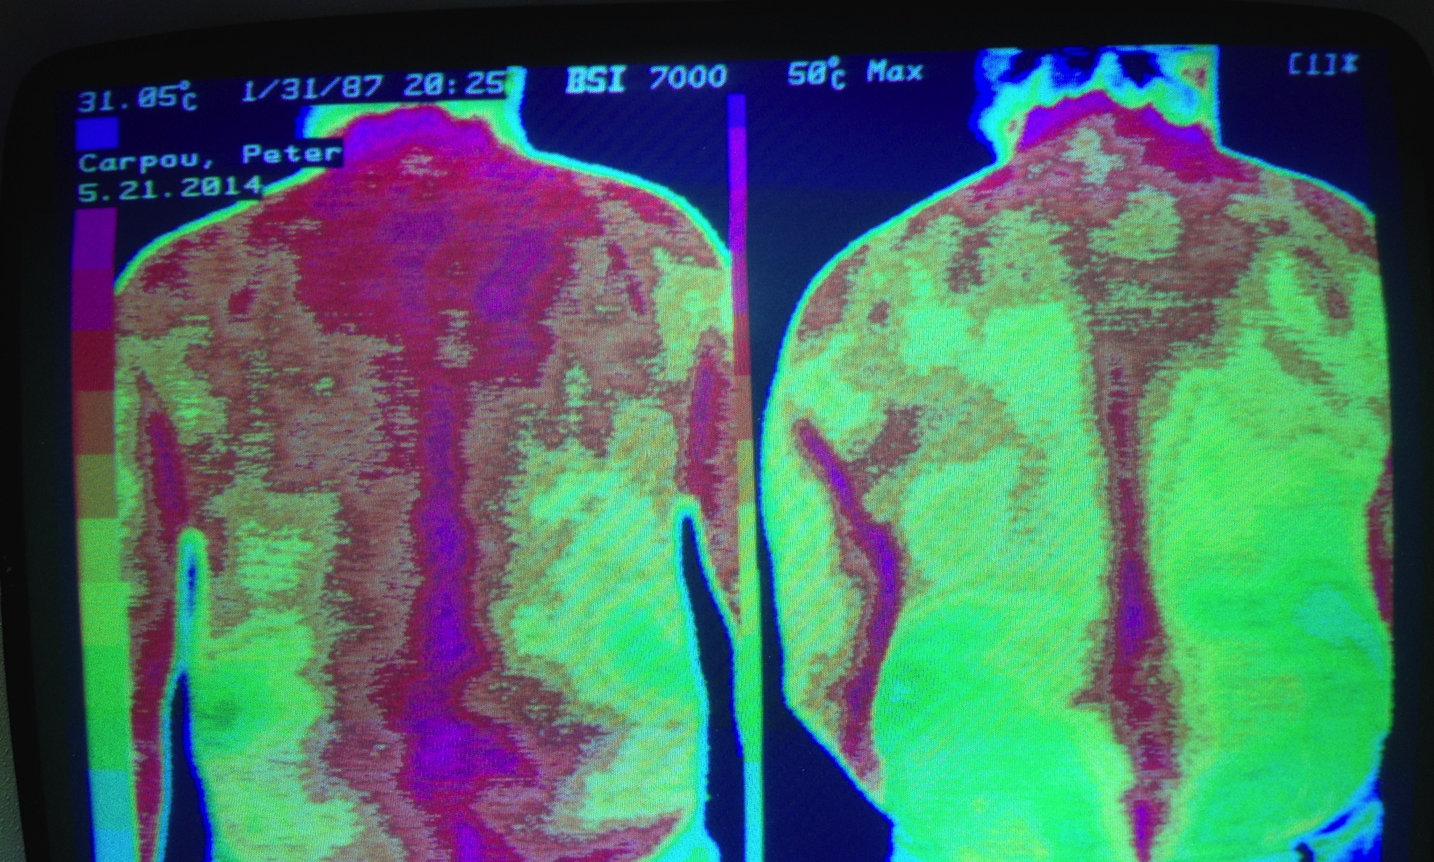
Diffuse Idiopathic Skeletal Hyperostosis (DISH)

Slide 35
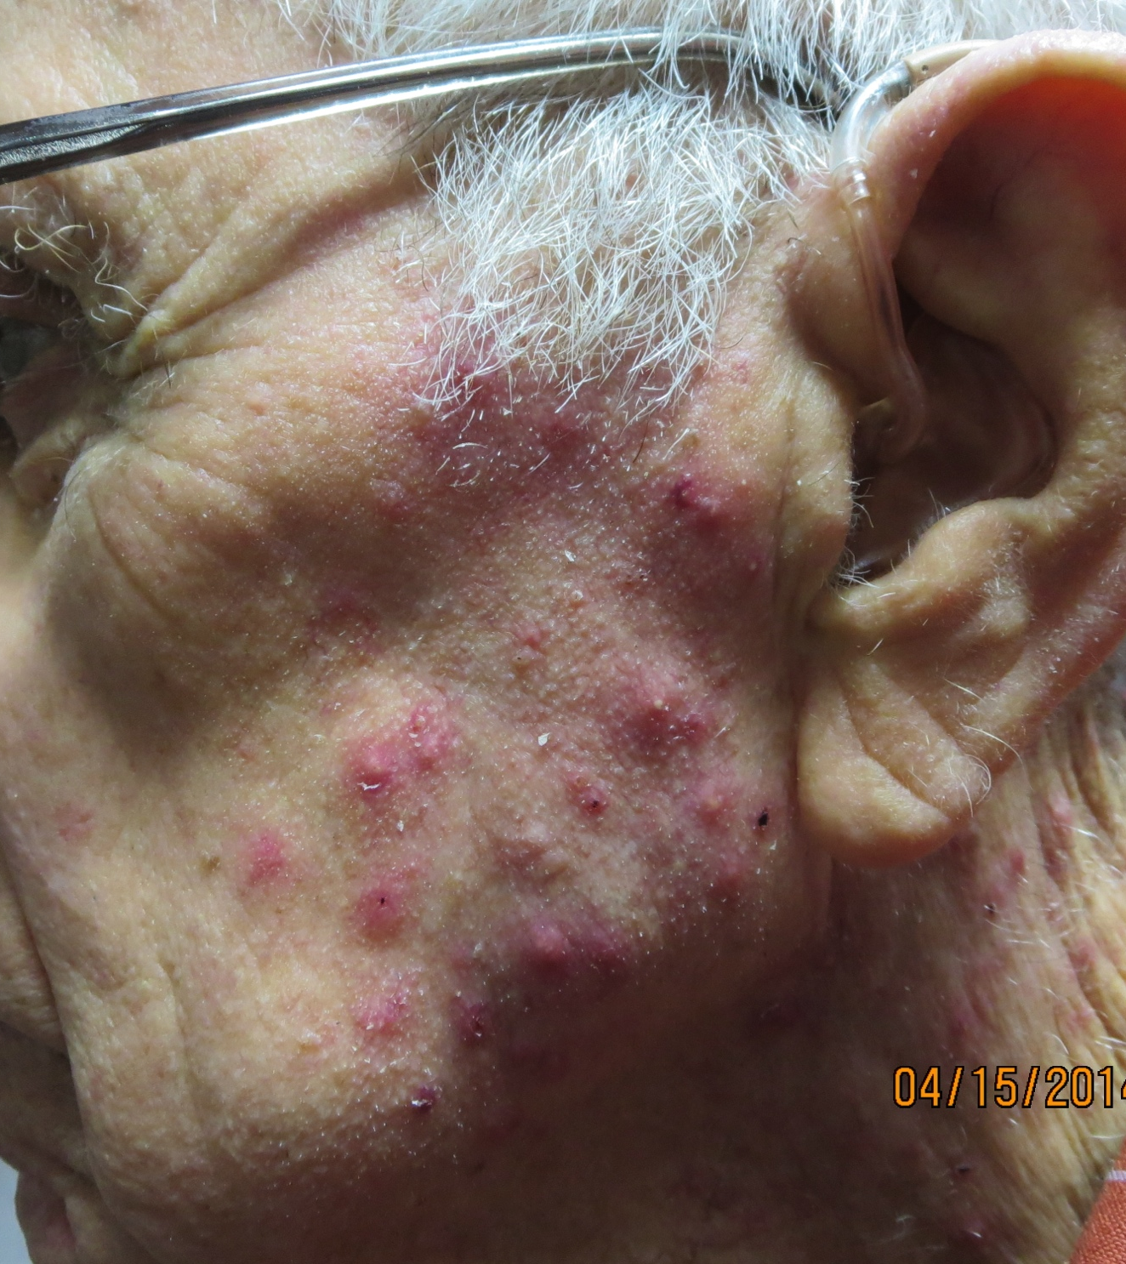
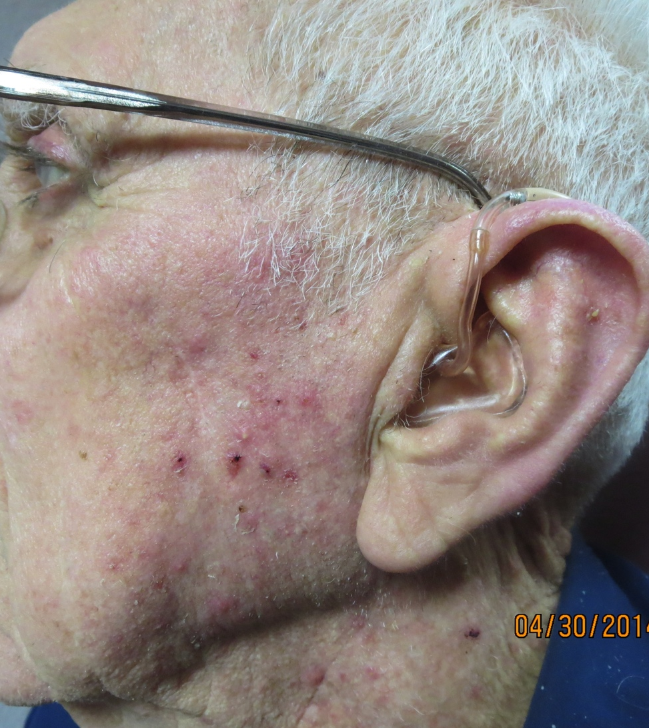
Acne for 20 Years

Slide 36
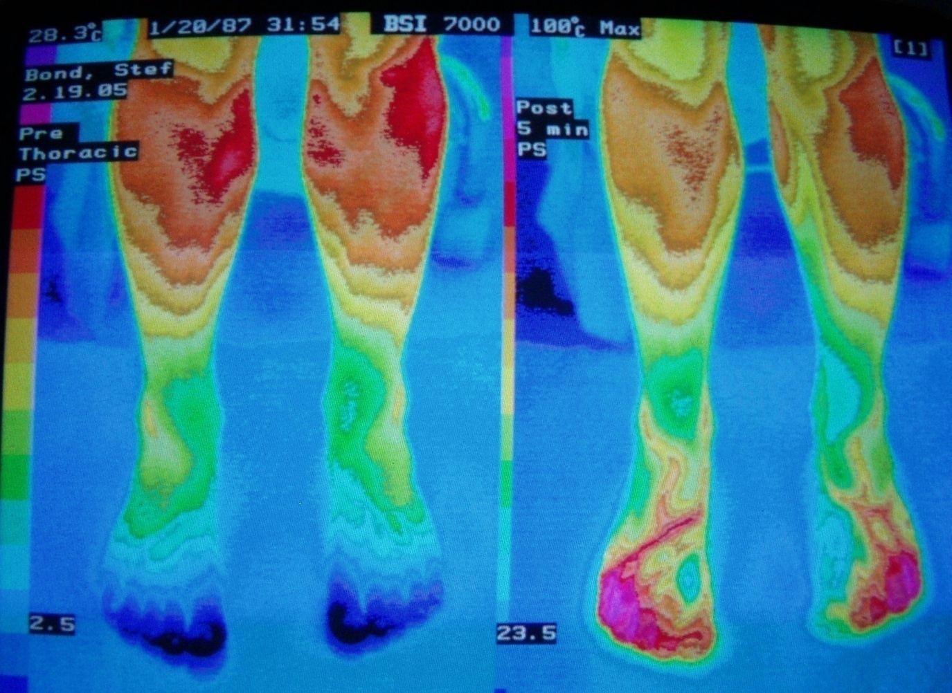
RSD

Slide 37
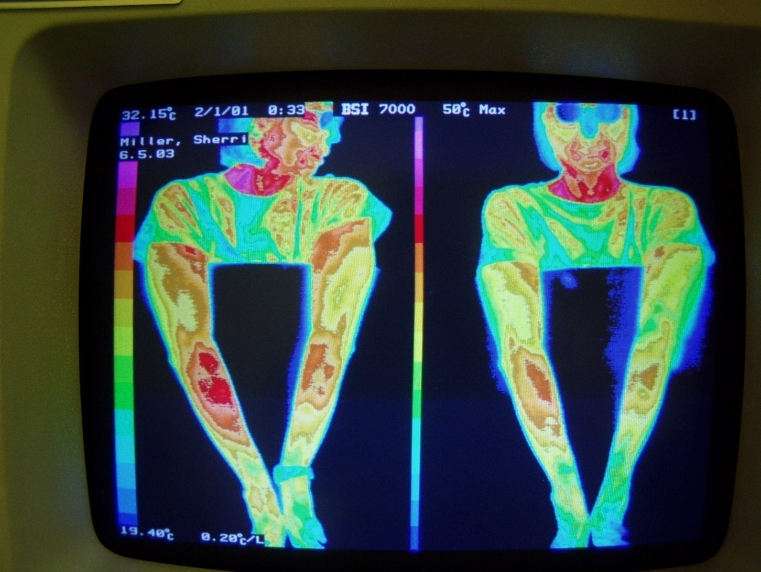
Tennis Elbow
Notes:
Tennis elbow

Slide 38
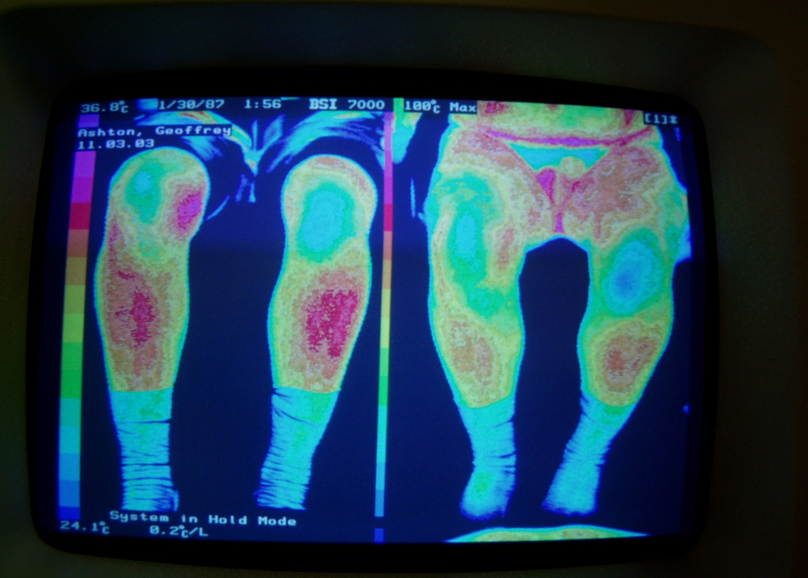
Osteoarthritis Knee

Slide 39
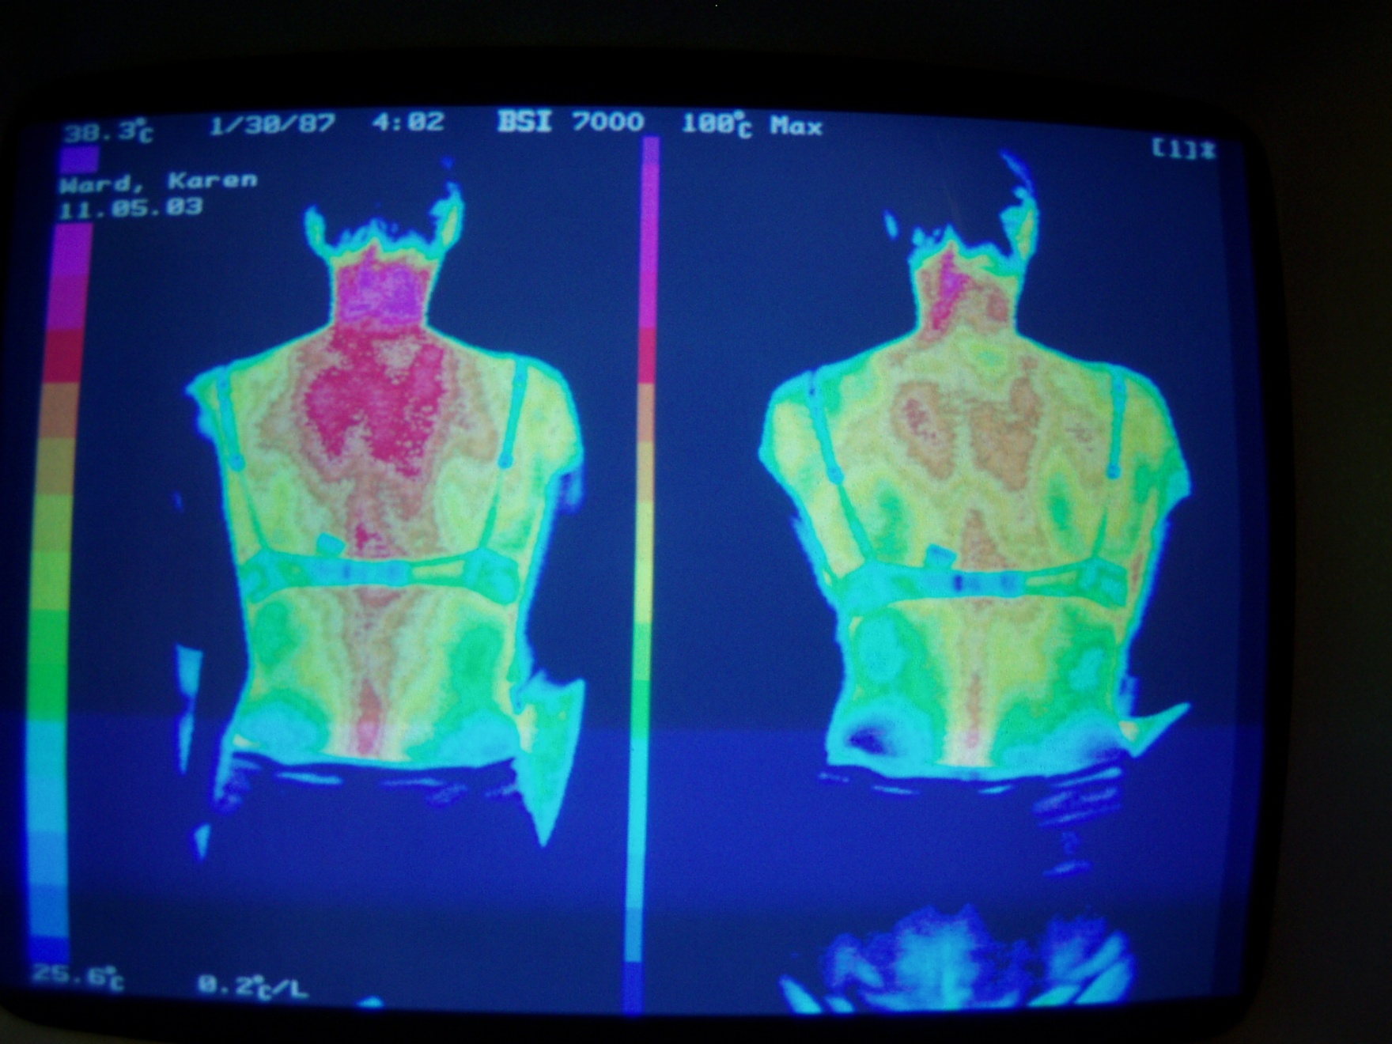
Cervical Disc/Headache
Notes:
Severe cervical disc disease and headaches

Slide 40
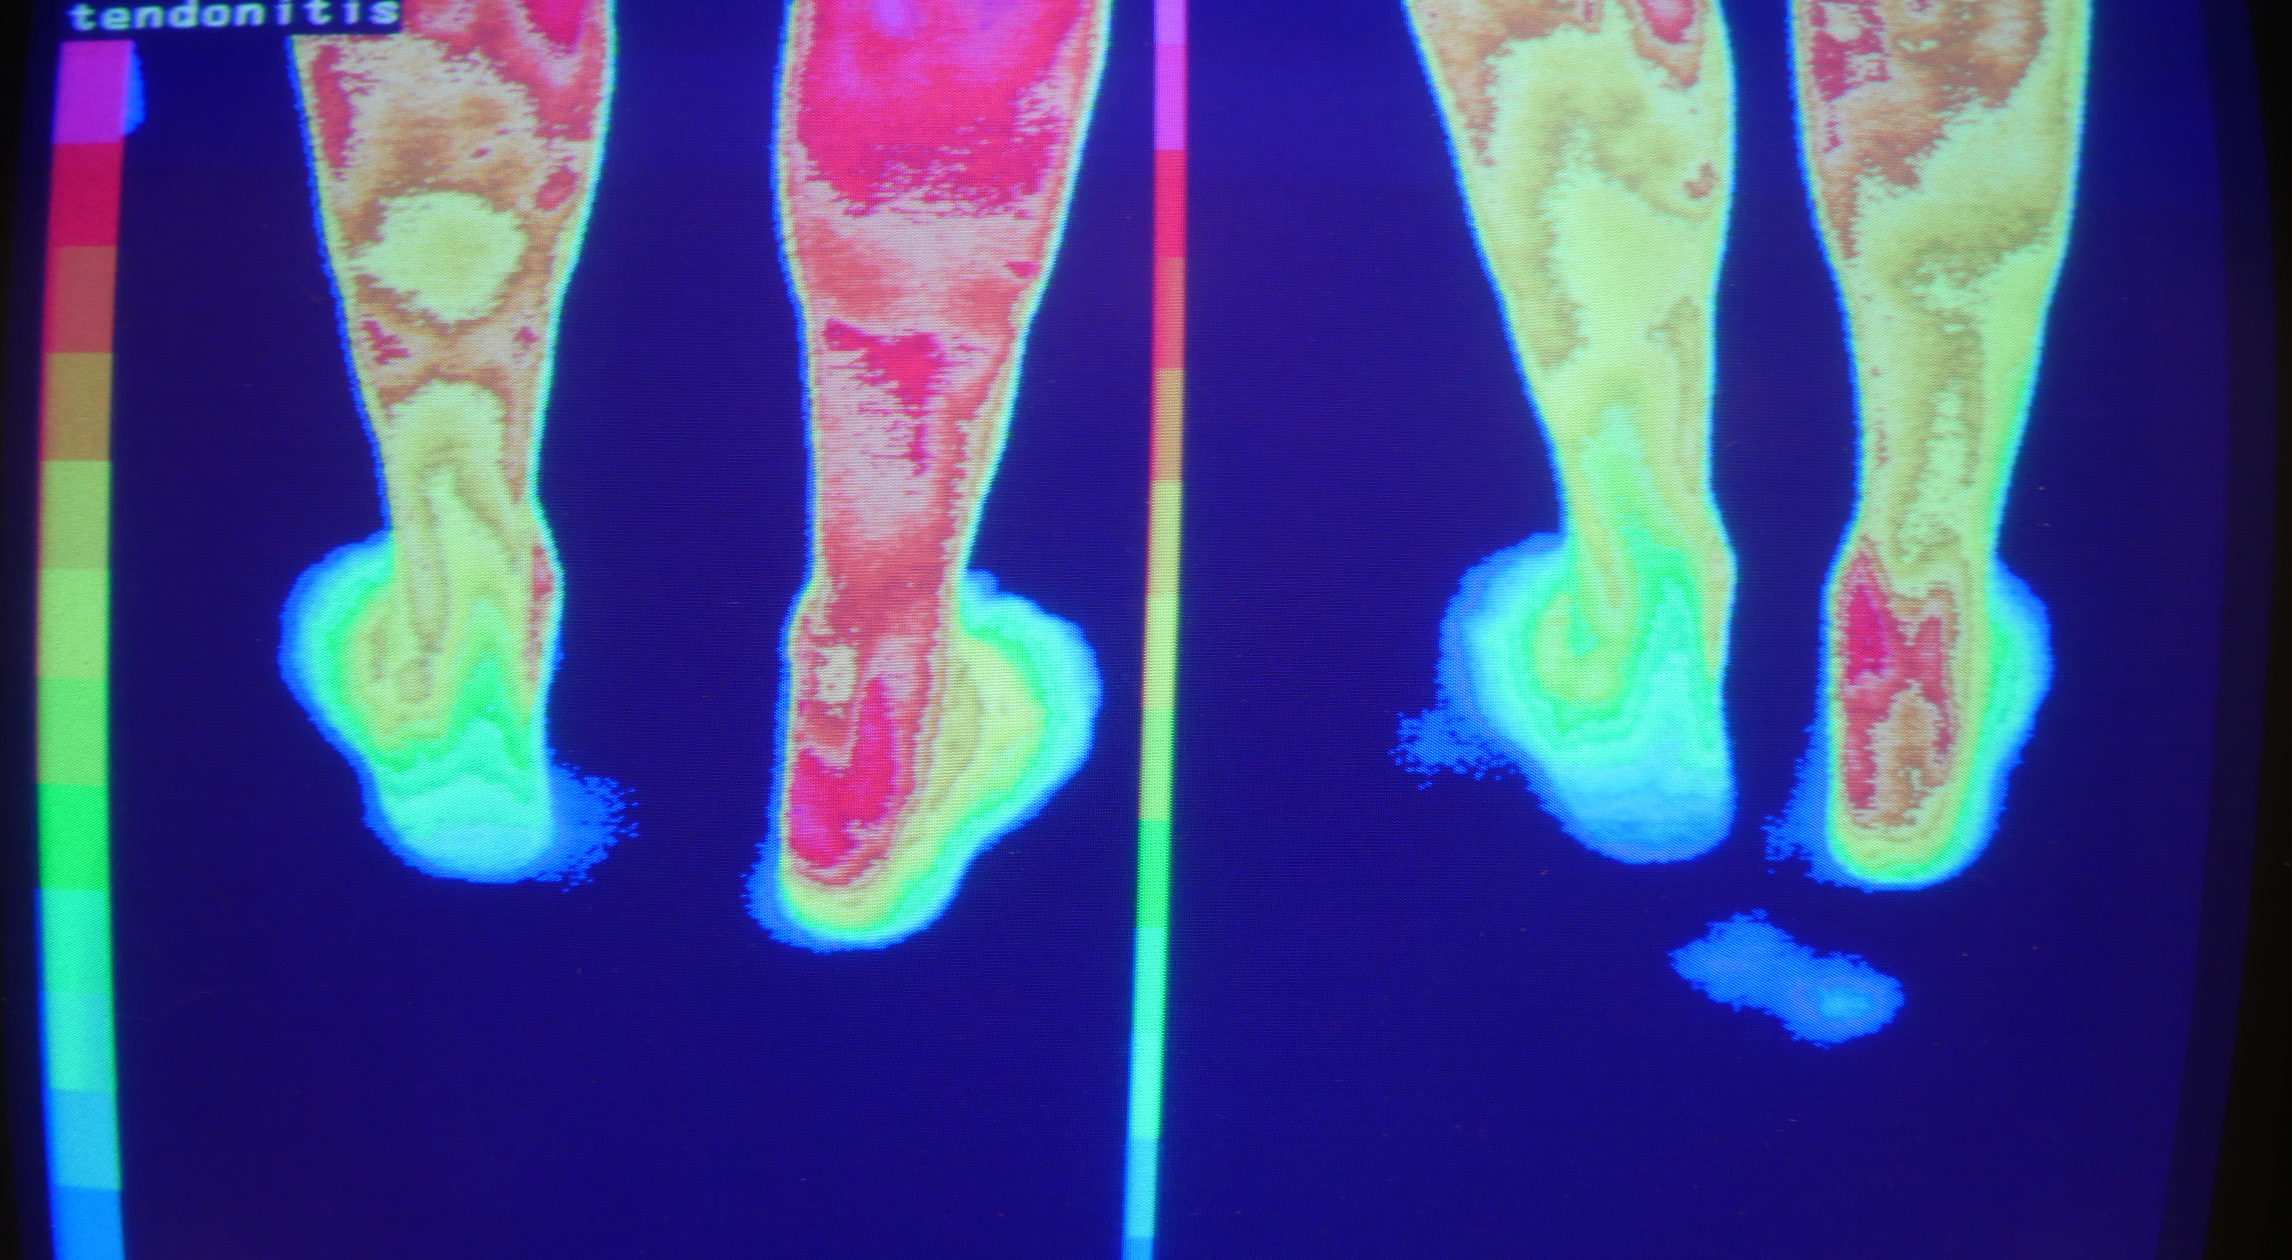
Achilles Tendonitis 1st Treatment
Notes:
56 year old male athlete with 18 months of unsuccessful treatment for Achilles tendonitis. 20% less pain after the first treatment.

Slide 41
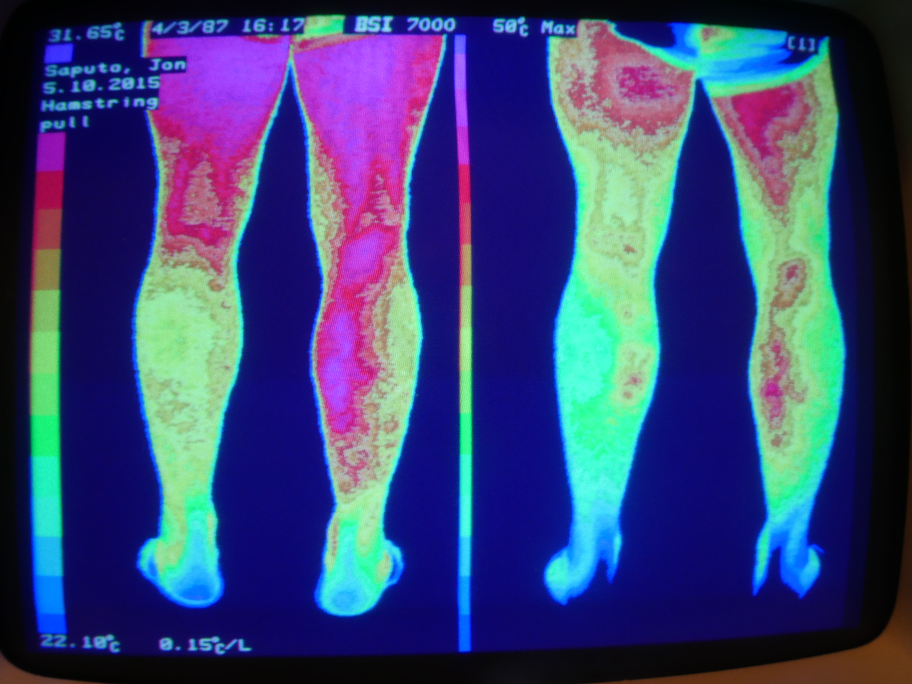
Hamstring Pull 1st Treatment
Notes:
44 year old male skier fell and pulled his left (yes left) gastroc two days ago. Is unable to walk without severe pain. No change in symptoms after this first treatment. We treated the left leg with light.

Slide 42
Peripheral Neuropathy Special Presentation:
Infrared Light for Neuropathy
Len Saputo, MD
www.DoctorSaputo.com
Link to free Peripheral Neuropathy Health Assessment:
http://doctorsaputo.com/a/peripheral-neuropathy-health-assessment
May 13, 2015
Alta Bates Summit
Comprehensive Cancer Center

