Slide 1
Expanding the Boundaries of Breast Cancer Screening
Breast Thermography
Len Saputo, MD
DrLen@DoctorSaputo.com
Maurice Bales
Merritt Hospital Tumor Board Presentation
August 27, 2014

Slide 2
About Breast Thermography
Measures infrared light emitted from breasts; 90% sensitivity & 90% specificity
Is a test of physiology, not anatomy
Helps differentiate benign vs malignant
Cold stressor test exposes cancers
Each person has a stable thermal fingerprint
Get a baseline at age 25
Is FDA approved as an adjunct to MMGs

Slide 3
Limits of Breast Thermography
Do we need more data in a prospective, randomized controlled study to assess sensitivity & specificity?
Consumers have no guarantee for credible testing or interpretation
Lack of standardization of training, equipment, and protocols
No standardized software for readings

Slide 4
Clinical Research Supporting Breast Thermography
Cancer, 1980, Vol 56, 45-51
Biomedical Thermology, 1982, 279-301
Thermology, 1986, Vol 1, 170-73
The Breast Journal, 1998, Vol 4 245-51
American Journal of Radiology Jan 2003, 263-69
Minnesota Medicine Dec 2009

Slide 5
Cancer
(1980; vol 56; p45-51)
58,000 patients with breast complaints were evaluated & followed
1245 with abnormal Th 3 scores were followed up to 12 years. All had MMGs
38% with normal breasts & 44% with mastopathy developed biopsy proven breast cancer within 5 years
90% with Th 4 or 5 had diagnosis made on their first visit.

Slide 6
The Breast Journal
(1998; vol 4; p245-51 Keyserlingk)
Retrospective study of 100 patients with biopsy proven cancer using pre-op clinical exam, mammography, and infrared imaging.
These cancers were: DCIS (4), stage 1 (42), stage 2 (54).
Sensitivity: 83 patients with breast cancer were identified using MMTs, 66 by MMGs and 61 with clinical exam.
The combination of CBE & MMG identified 83 cases. Adding MMTs increased sensitivity to 98%.
Infrared imaging picked up 31 of 39 cancers missed by clinical exam and 10 of 15 by MMG. Infrared imaging missed 17 cases.
The average tumor size using MMGs was 1.66 cm & was 1.28 cm using MMTs.

Slide 7
Biomedical Thermology
Gautherie et al 1982; p 279-301
Followed 10,834 women with Sxs for 2-10 years with CBE, MMGs, and MMTs
Followed 387 people with Th3 & normal CBEs and MMGs & followed for < 3 yrs
33% of patients without symptoms developed breast cancer
41% of Patients with mastopathy developed cancer

Slide 8
Thermology
(1986; Vol 1; 170-73)
Compared the effectiveness of MMG, CBE, and breast thermography in the detection of breast cancer
Thermography had the best results of the 3 modalities
When all three were used, there was a 98% effectiveness in finding breast cancers

Slide 9
American Journal of Radiology
January 2003; 263-69
Reported MMT had a 99% sensitivity in finding breast cancers
However the specificity was only 15%
A negative breast thermogram in this setting is powerful evidence there is no cancer

Slide 10
Highlights From Breast Thermography Studies
Advances in infrared technology and data on 300,000+ women show that breast thermography can identify 90-95% of breast cancers with 90% accuracy
Breast thermography is safe, easy to do, is private, and affordable
Breast thermography is FDA approved
Begin breast cancer screening at 25
It works in women with dense breasts

Slide 11
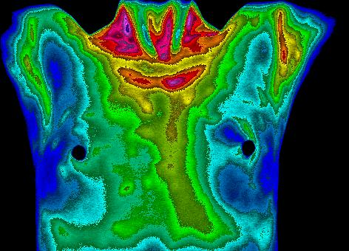
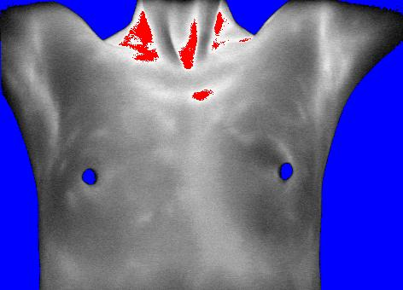
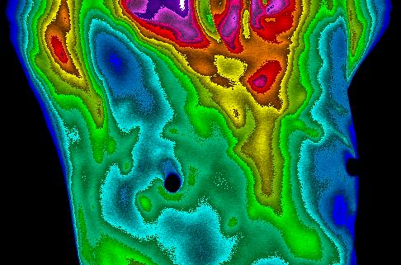
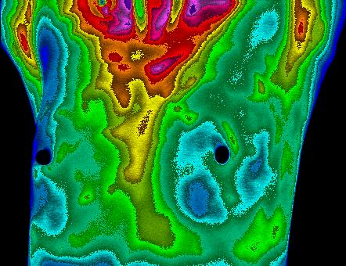
Normal Breasts
Front View, color
Front View, grayscale
Right Breast View
Left Breast View

Slide 12
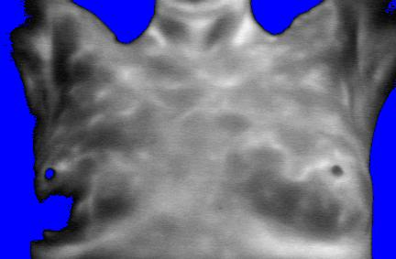
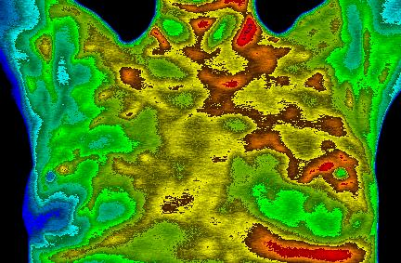
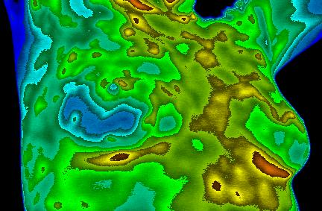
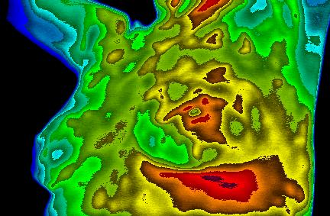
Normal Breasts? No
Front View, Gray
Front View, Color
Right Oblique
Left Oblique

Slide 13
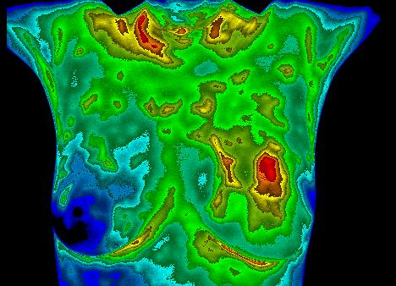
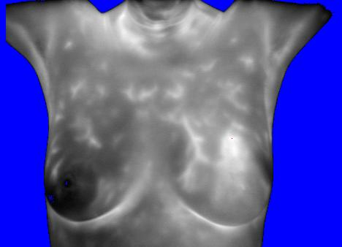
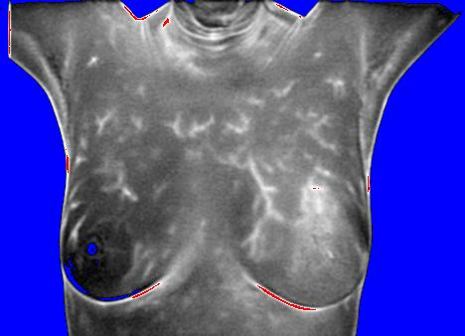
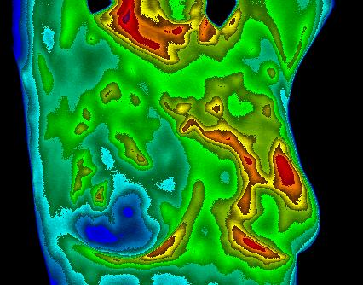
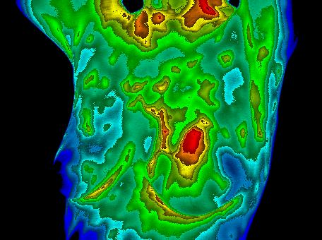
Cancerous Tumor
Front View, color
Front View, gray scale
Front View, processed
Right Breast View
Left Breast View

Slide 14
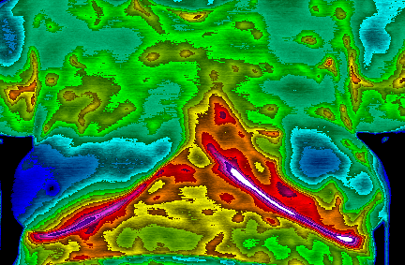
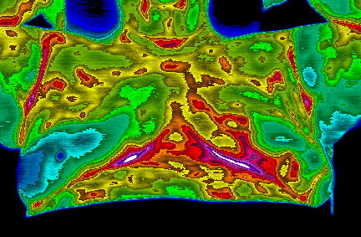
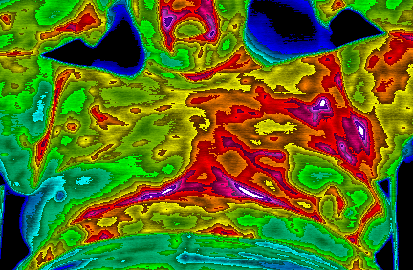
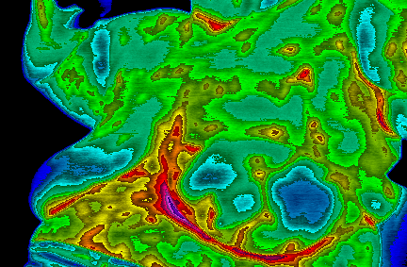
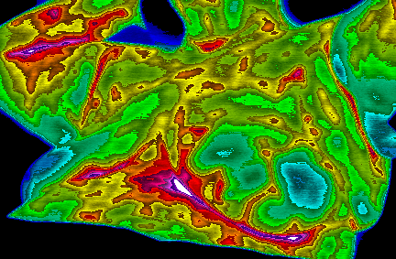
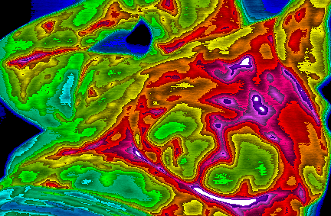
Case Study #2: Suspicious Lesion (Cont’d)
4/10/08
12/11/08
3/26/09
Front View, color
Left Oblique, color

Slide 15
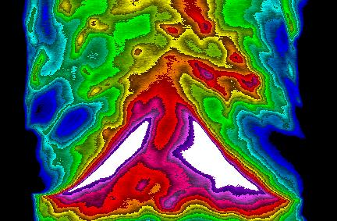
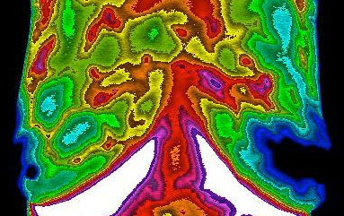
Breast Thermograms
Showing Cancer Development
October 2013 July 2014

Slide 16
Conclusions
There is considerable data documenting the value and safety of MMTs.
Breast thermography adds to identifying breast cancer in combination with existing technologies
Breast thermograms have nothing to do with MMGs; the question is, “Do they add to our ability to identify breast cancers?”
Is there any stand alone test for breast cancer screening?

Slide 17
Consider these Possibilities: Can Breast Thermography…
Differentiate significant cancers from those with minimal risk?
Reduce treatment for minimal-risk disease?
Support informed decisions about prevention, screening, biopsy and treatment?
Help identify the highest risk patients and suggest preventive interventions?
Monitor high risk women as an option to bilateral mastectomy?

